Slide 1
Airline Reviews
INSY 669 - Group 16
Diwei Zhu, Kexin Wang, Alice Liu, Ziye Zhang, Yichen Wang, Jiahua Liang
Text Analysis for

Slide 2
Background & Problem Statement
BACK-
GROUND
In the evolving big data era, massive amounts of user generated content have become a valuable source for airline enterprises to engage in real-time interactions with potential customers and gain insights of differents aspects that could influence the business.
Analyze popular airlines and understand how people feel about them by using text mining.
Provide recommendation to customers by leveraging sentiment analysis and airlines segmentations
Provide advice to airlines by leveraging regression analysis of airlines and their attributes.
GOALS
Scraped Reviews from popular Airlines Review Platforms: ConsumerAffairs, Skytrax
https://www.consumeraffairs.com/travel/airlines.html https://www.airlinequality.com/review-pages/latest-airline-reviews/
DATA
SOURCE
ATTRI-
BUTES
Notes:
Hello everyone, Thank you all for being here. we are group 16. Today we are going to talk about text mining for the airlines industry
As you know, we are in the era of big data and User Generated Content is everywhere. In Airlines industry, UGC includes the customer reviews of different airline companies. We could leverage the reviews to understand how each airline is viewed by customers, and assess their strengths and weaknesses.
We aim to achieve 3 goals from our analysis.
First, we’d like to analyze these reviews to understand how people feel about each airline.
Second, by using sentiment analysis and airline segmentation clustering, we aim to provide recommendations to customers such as how to select airlines based on their preferences.
Third, we also aim to provide advice to airlines such as in which area they could improve.
We get the airlines reviews data from two well-known airline forums. Consumer Affairs and Skytrax. The number of reviews is equally extracted from each airline. Furthermore, we replace some airline-related detailed attributes by higher level attributes.

Slide 3
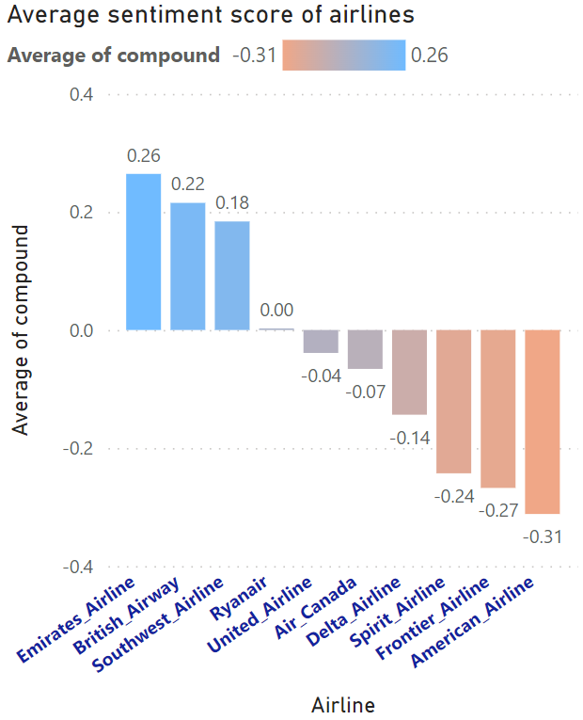
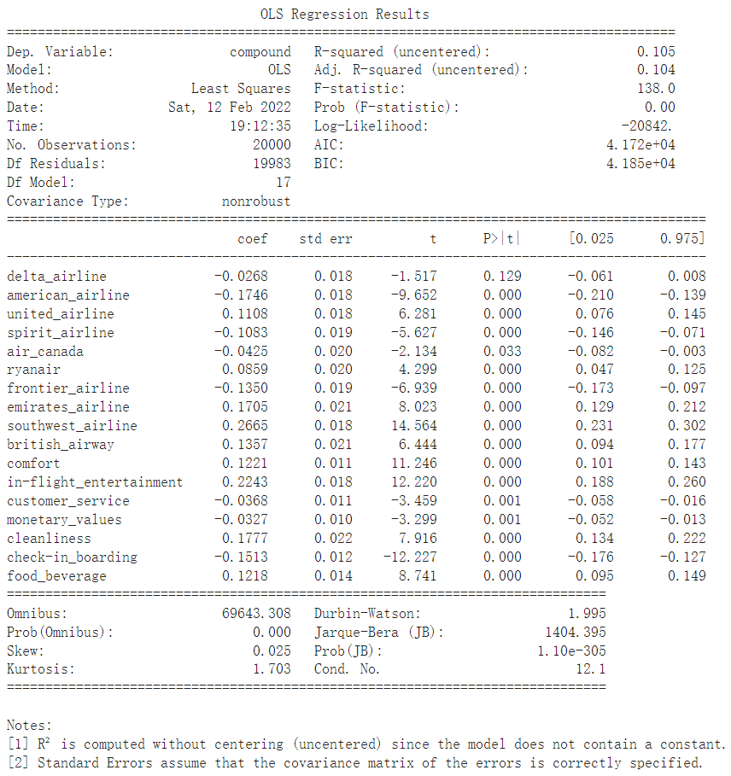


Word & Sentiment Analysis
Which is the most beloved airline? Which is hated the most?
Which brand present stronger relationship to more positive/negative sentiments?
Average sentiment score in dashboard
High Brand Reputation
Comfort, Clean, Good Service
Poor Customer Service, Unsatisfactory Meal
Notes:
(will show power BI here)We did word analysis and sentiment analysis, and based on the generated compound sentiment scores, we constructed an interactive dashboard that visualizes the sentiment in reviews of each airlines or in terms of certain attributes.
At the left side, a bar chart shows the average sentiment score of all reviews that mention a certain airline, indicating the most beloved airline, which is Emirates, and the most hated airline, which is American Airlines.
At the right side, a series of visualizations shows a comparison between the average sentiment scores of reviews that did and did not mention a certain attribute. 0 means reviews that did not mention the attribute, and 1 means a mention. For example, as shown in the second graph, reviews that mentioned in-flight entertainments in general have much more positive sentiments compared to those did not.
By clicking on the slicers, we can also zoom in to one airline, or show the sentiment scores of airlines based on reviews that did mention ‘Comfort’. This dashboard serves as a basis for our business insights and recommendations that will present later.
Base on the sentiment score and binary variables that indicates whether an airline is mentioned or not, we have run a regression model to see how the mentioning of each airline impact the score of each review, where the coefficients represent the percentage of change on sentiment score. According to the table, we could see that american airline have the lowest coefficient and in contrast, southwest airline and emirates airline have the highest coefficient. This means that reviews containing american airline will have negative impact on the score, which proves conclusion drawn from the average sentiment score mentioning before.

Slide 4
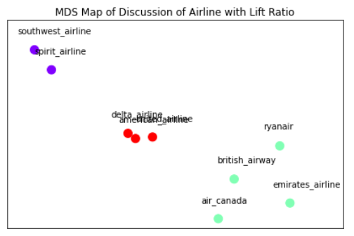
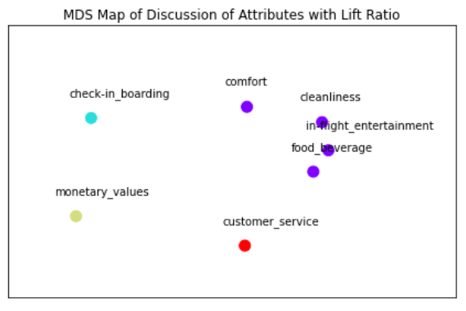
Airlines Segmentation
Airline Clustering
Group 1: Southwest Airlines, Spirit Airlines
Group 2: United Airlines, Delta Airlines, American Airlines
Group 3: Emirates Airlines, British Airway, Ryanair, Air Canada
Insights
Airlines segmentation mainly based on price and countries
Group 1 and 2 all consisted of US airlines, each with high similarity
Group 1 consisted of the most popular US low-cost airlines
Group 2 consisted of the most popular US full-service airlines
Group 3 consisted of airlines from other countries
Attribute Clustering
Group 1: Check-in & Boarding
Group 2: Monetary Values
Group 3: Customer Service
Group 4: Comfort, Cleanliness, In-flight Entertainment, Food & Beverage
Insights
Group 1-3 are the top 3 attributes in the sentiment score
Group 4 contains customer in-flight experience
Notes:
We performed K means clustering and created two multi dimensional map for airlines and attributes. By attributes we means different factors that affect a customer’s experience with an airline company. In the first plot we see that the algorithm splits airlines into three groups. We see that airline segmentation is mainly based on price and countries, with group 1 consisted of cheap american airline, group 2 with US airline tycoons. The second MDS map clusters different attributes together. From this map we see that attributes check-in and boarding, monetary values and customer service each form their own group. The remaining attributes are related with customer’s in flight experience, and they are all in one group. These two graphs provide useful info that lead to the next part.

Slide 5

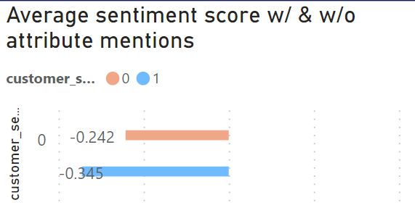
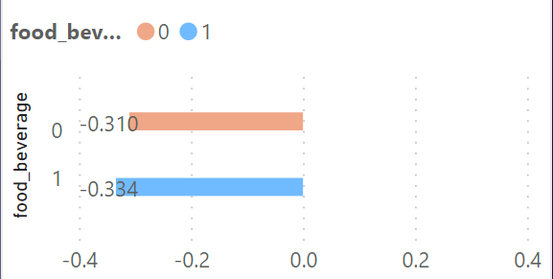
Recommendations to entities
Customers : Which airline to choose if you have different requirements.
aIRLINES: Which attributes should be improved?
The attributes to be improved are those currently have negative effect on the sentiment score
Airline that has the highest sentiment score across all reviews that mentioned certain attribute(s)
Luxury air trip
Emirates Airline
In-flight entertainment 22.43%
Sensitive to delay
British Airways
Cleanliness 17.78%
Sensitive to price
Southwest Airlines
Comfort
12.21%
In-flight experience
Emirates Airline
Food beverage
12.18%
Notes:
We recommend airline to customers with different needs based on the aggregated sentiment scores for attributes.
For those who would like to have luxury customer service experience and don’t care too much about the price, Emirate Airline definitely would be the top choice for them, it achieves overall the highest sentiment score on all the attributes.
British Airlines does well in check-in & boarding, so we recommend it to customers who are sensitive to delay and care about time, for example, business travelers.
For customers who are price sensitive, we recommend Southwest Airlines, it’s the world’s largest low-cost carrier, it has the highest monetary values.
We notice that if we sum all the in-flight experience attributes together, Emirates again, has the highest sentiment score, so for those customer who care about how they feel during the flight, we suggest Emirates
We can also advise the airlines to improve certain aspects of their service based on the sentiment analysis results. As an example, the picture here shows the impact of two attributes, customer service and food & beverage, on the average sentiment score of the reviews for American Airline. The red bar is the average sentiment score of all the reviews excluding those mentioned this particular attribute. The blue bar is for all the reviews. Here, both the customer service and food & beverage have negative impact on the customer review. In this example, we would recommend American Airline to improve their customer service and their food service. The same analysis can be done for all other attributes for American Airline, and also for all other airlines. We can recommend airlines to improve on those attributes that have negative impact on their review sentiment score.

Slide 6
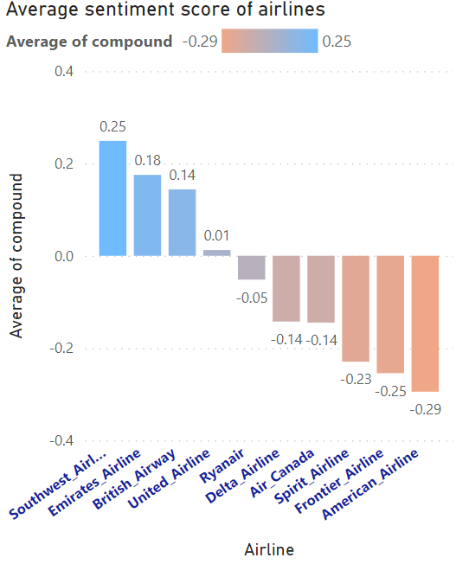
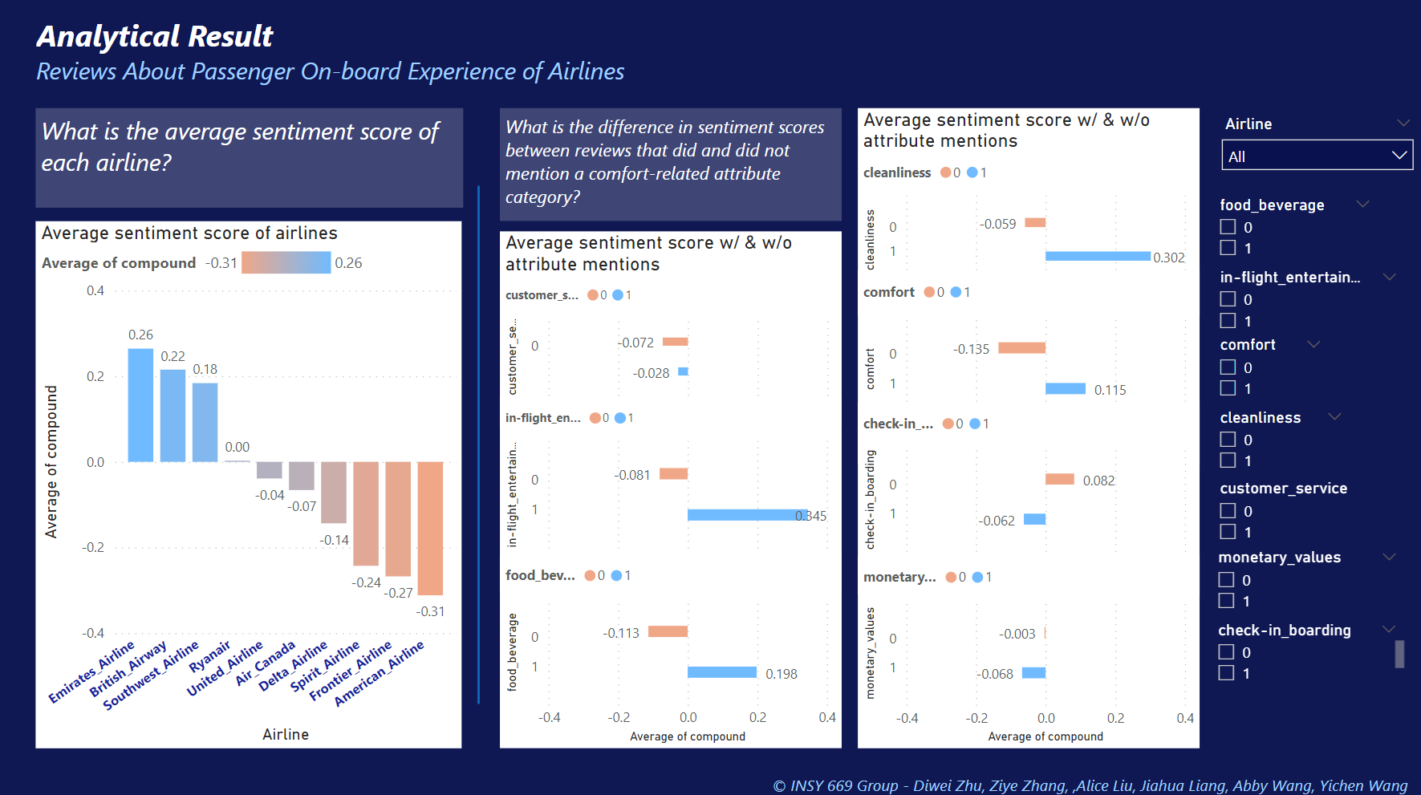
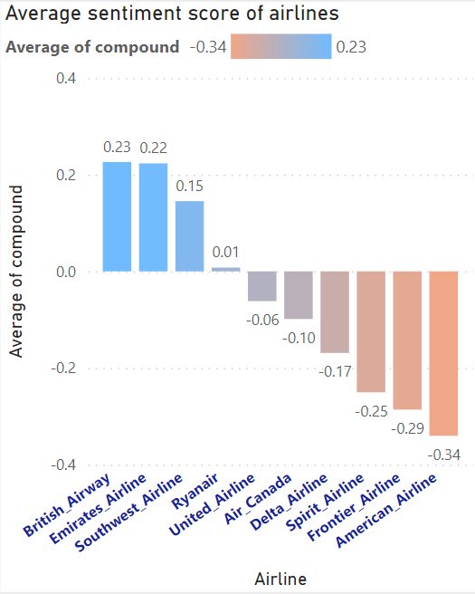
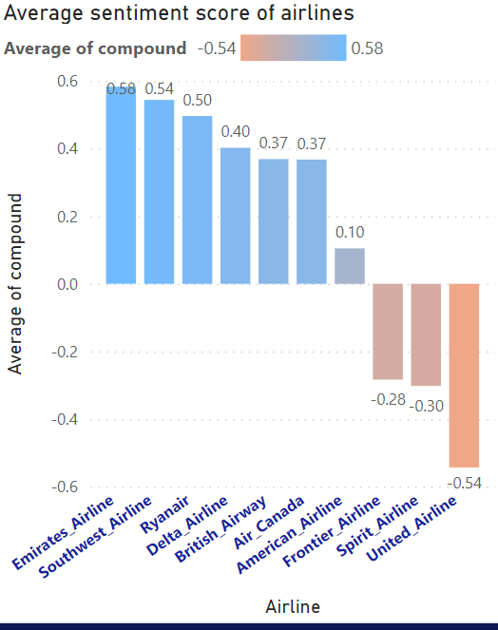
Appendix
Airlines of the highest sentiment score for recommendation
Sensitive to price:
Avg sentiment score of reviews that mention: “monetary_values”
Interactive Power BI dashboard - (.pbix file attached in submission)
Sensitive to delay:
Avg sentiment score of reviews that mention: “check in_boarding”
In-flight experience:
Avg sentiment score of reviews that mention: “food & beverage”, “comfort”, and “entertainment”.

